Slide 1

Developing a Machine Learning-Based Tool for Identifying Plant Diseases
Project ID: 23MP0144

Slide 2
Group Members
Aditya Bhardwaj
Registration Number - RA1911003030190
Yash Singhwal
Registration Number - RA1911003030197
Deepanshu
Registration Number - RA1911003030204
Paras Rajpal
Registration Number - RA1911003030238
GUIDE: Dr. Chandra Shekhar Tyagi

Slide 3
Table of Contents
Introduction
Literature Survey
Existing Problem and Proposed Solution
Architectural Design of the Proposed System
Dataset/ Database Specification
Methodologies
Implementation and Expected Outcome
Conclusions
Future Work
References

Slide 4
Introduction
The detection of plant diseases is critical in ensuring the health and productivity of crops. Automatic techniques for detecting plant diseases have become increasingly important in monitoring large farms and alerting producers to the appearance of diseases on plant leaves. The timely and accurate detection of plant diseases is vital, especially given the increasing global population and the need to grow enough crops to feed the world.
Unfortunately, plants can be affected by various diseases that cause a significant loss in productivity. These diseases can result in decreased yield, poor quality crops, and an increased risk of contamination. Plant diseases can also spread quickly and affect large areas of crops, leading to devastating consequences for farmers and the food supply.

Slide 5
Introduction Contd.
To combat these issues, we can utilize a combination of various technologies, including artificial intelligence, machine learning, convolutional neural networks (CNN), and deep learning. By implementing advanced techniques, we can provide smarter solutions for detecting and identifying plant diseases.
Plant disease detection is classified as a predictive modeling problem, where a class label is predicted for a given input data example. This means that the output of the model will be either "yes" or "no," indicating whether the plant is diseased or healthy.
The use of artificial intelligence and machine learning techniques in plant disease detection has proven to be highly effective. By training machine learning models on large datasets of images of healthy and diseased plants, the models can learn to recognize the visual patterns associated with different types of plant diseases.

Slide 6
Literature Survey
Paper and Author | Methodology | Conclusion
Detection of leaf disease and classification using digital image processing - By RM Prakash (Year - 2012) | SVM, and K-means | Classifying different plant diseases and improving the classification accuracy.
Applying image processing technique to detect plant diseases - By Kulkarni et al (Year - 2012) | ANN | As the proposed approach is based on ANN classifier for classification and Gabor filter for feature extraction, it gives better results with a recognition rate of up to 91%.
Detection of unhealthy region of plant leaves and classification of plant leaf diseases using texture features - By Arivazhagan Selvaraj (Year - 2013) | Transformation, Segmentation and Classification | A color transformation structure is taken for the input RGB image, and then by means of a specific threshold value, the green pixels are detected and uninvolved, which is followed by segmentation process, and for obtaining beneficial segments the texture statistics are computed.

Slide 7
Literature Survey Contd.
Paper and Author | Methodology | Conclusion
Detection and Classification of leaf disease using Artificial Neural Network - By Malavika Ranjan, Manasi Rajiv Weginwar and A. Ingole (Year - 2015) | ANN | Artificial Neural Network (ANN) is trained by properly choosing feature values to distinguish diseased plants and healthy samples. The ANN model achieves an accuracy of 80%.
Deep learning for Image based Plant detection - By Sharada P. Mohanty, David P. Hughes (Year - 2016) | CNN | The CNN model is trained to identify healthy and diseased plant of 14 species. The model achieved an accuracy of 99.35% on test set data. When using the model on images procured from trusted online sources, the model achieves an accuracy of 31.4%, while this is better than a simple model of random selection, a more diverse set of training data can aid to increase the accuracy.

Slide 8
Literature Survey Contd.
Paper and Author | Methodology | Conclusion
Cucumber disease detection using artificial neural network - By P. Pawar (Year - 2016) | ANN | Classification accuracy can be increased by using additional texture features.
Detection and measurement of paddy leaf disease symptoms using image processing - By RP Narmadha (Year - 2017) | ANN | It evaluates the techniques in image processing, detecting diagnosing of crop leaf disease.
Convolutional Neural Network based Inception v3 Model for Animal Classification – Jyotsna Bankar (Year - 2020) | CNN | Inception v3 can be used to classify objects as well as to categorize them, this capability of inception v3 makes it instrumental in various image classifiers.
"Plant disease detection using CNN and GAN" - By Emanuel Cortes (Year - 2022) | CNN and GAN | Background segmentation is used for ensuring proper feature extraction and output mapping. It is seen that using GAN’S may hold promise to classify diseases in plants.

Slide 9
Existing Problem and Proposed Solution
The major problem that farmers face is the timely and accurate detection of plant diseases. The inability to detect diseases promptly can lead to reduced crop productivity and, ultimately, food shortages for the growing population.
To address this challenge, we propose a solution that involves using machine learning algorithms to identify and classify plant diseases from captured images of plant leaves. Our approach would potentially include a medicinal section for treatment if time permits, providing a comprehensive solution for farmers.
We aim to develop a web application that farmers can access easily, using React, FastAPI, and other algorithms. The application will provide farmers with a user-friendly interface to upload images of diseased plants and receive accurate diagnoses of their condition.
By leveraging advanced technologies such as artificial intelligence, Machine Learning, CNN, and Deep Learning, our solution provides a smarter and more efficient way of detecting and treating plant diseases.

Slide 10
Architectural Design of the Proposed System
Image Capture and Processing.
Feature Extraction (EDA).
Dataset Division.
Training set (80%), validation set (10%) and Testing set (10%)
Model Training and Validation.
Display and Comparison of results.
Disease Detection in Plant.

Slide 11
Architectural Design of the Proposed System Contd.
Figure: Architectural Design
Image Acquisition
Image Pre-Processing
Segmentation
Classification
Feature Selection

Slide 12
Architectural Design of the Proposed System Contd.
Image Acquisition
Image acquisition can be defined as the act of procuring an image from sources. This can be done via hardware systems such as cameras, encoders, sensors, etc.
Image Pre-processing
Image preprocessing is the steps taken to format images before they are used by model training and inference. This includes, but is not limited to, resizing, orienting, and color corrections.
Segmentation
Image segmentation is a commonly used technique in digital image processing and analysis to partition an image into multiple parts or regions, often based on the characteristics of the pixels in the image. Image segmentation could involve separating foreground from background, or clustering regions of pixels based on similarities in color or shape.

Slide 13
Architectural Design of the Proposed System Contd.
Feature Selection
The input variables that we give to our machine learning models are called features. Each column in our dataset constitutes a feature. To train an optimal model, we need to make sure that we use only the essential features. If we have too many features, the model can capture the unimportant patterns and learn from noise. The method of choosing the important parameters of our data is called Feature Selection
Classification
In Classification, a program learns from the given dataset or observations and then classifies new observation into a number of classes or groups. Such plant is healthy or having any diseases.

Slide 14
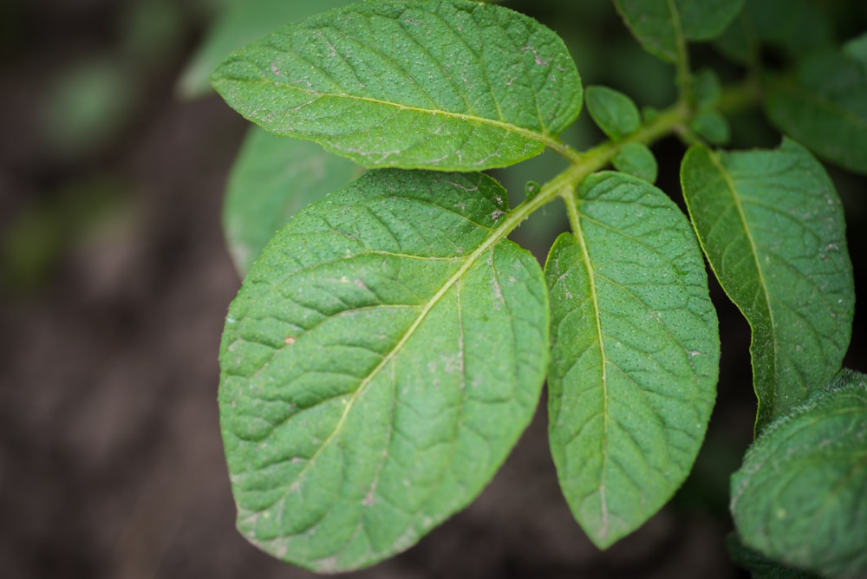
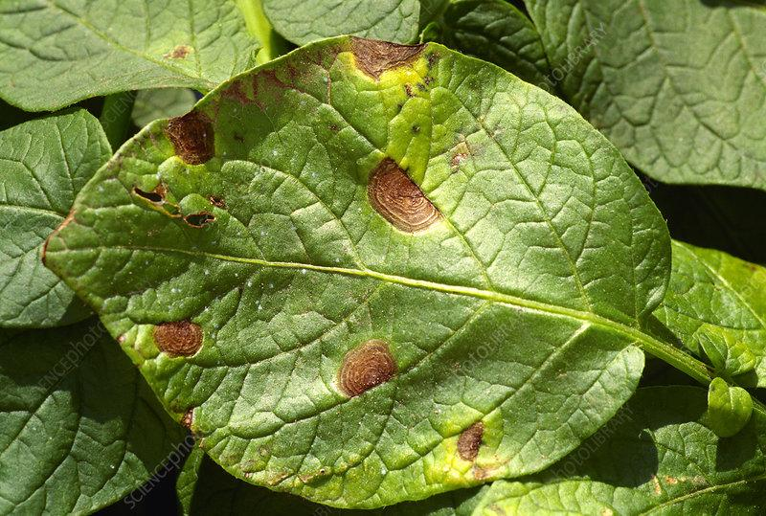
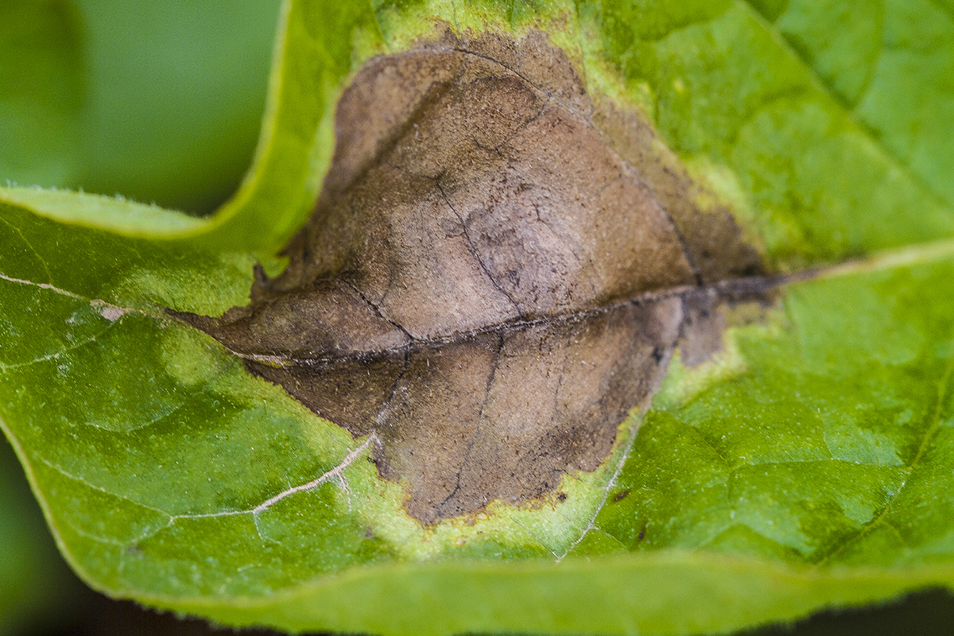
Dataset/ Database Specification
Healthy Leaf Early blight Late Blight

Slide 15
Dataset/ Database Specification Contd.
The training and testing datasets each contain high-quality, real-life symptom images of several potato disease that are divided into three groups:
Potato Early blight (Early blight)
It is a sickness of potato brought on via the fungus Alternaria solani.
Potato Late blight (Late blight)
It is induced by way of the fungus like oomycete pathogen Phytophthora infestans. This probably devastating sickness can infect potato foliage and tubers at any stage of crop development.
Potato healthy
The Potato is healthy

Slide 16
Methodologies
Machine Learning.
Deep Learning.
CNN ( Convolution Neural Network )
Sequential model.
TensorFlow.
Image Processing ( PIL, keras )
ReactJs.

Slide 17
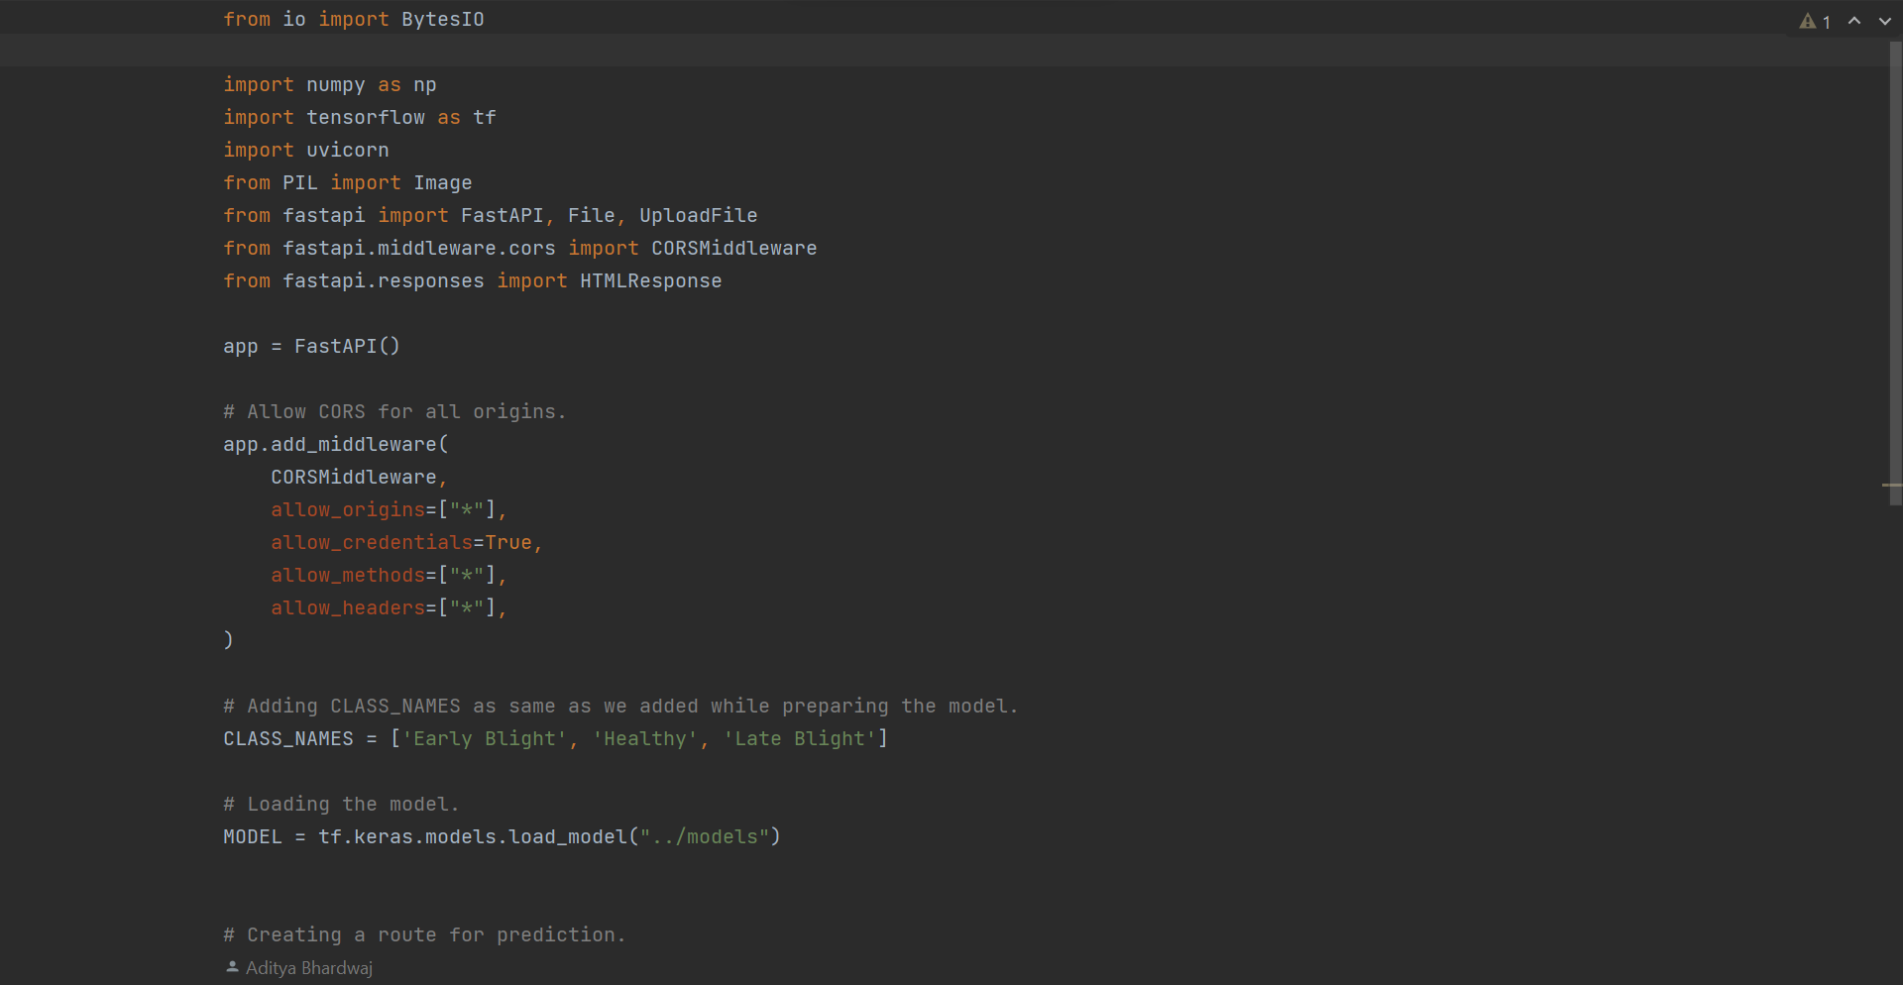
Code Implementation

Slide 18
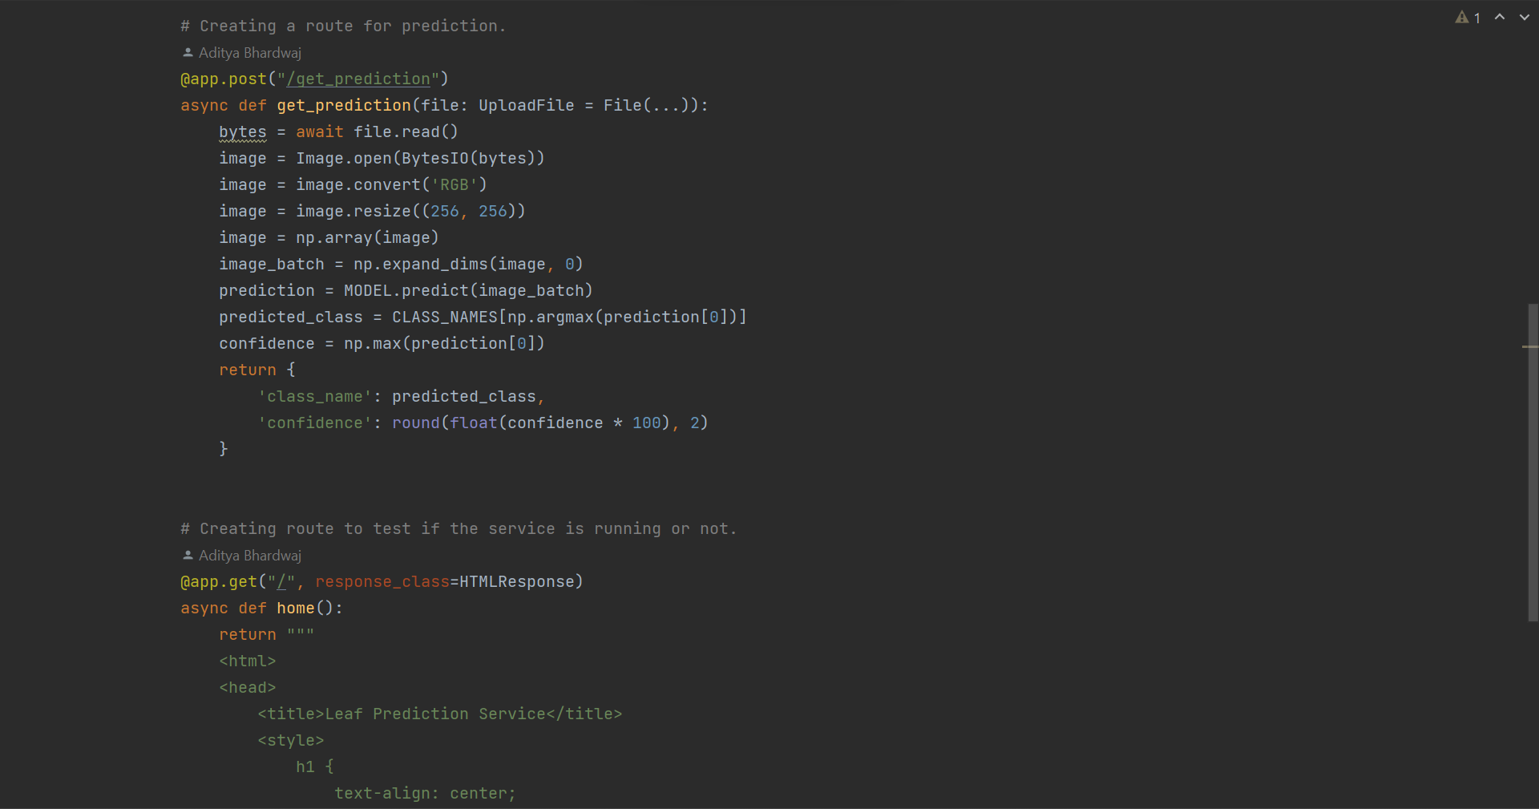
Code Implementation Contd.

Slide 19
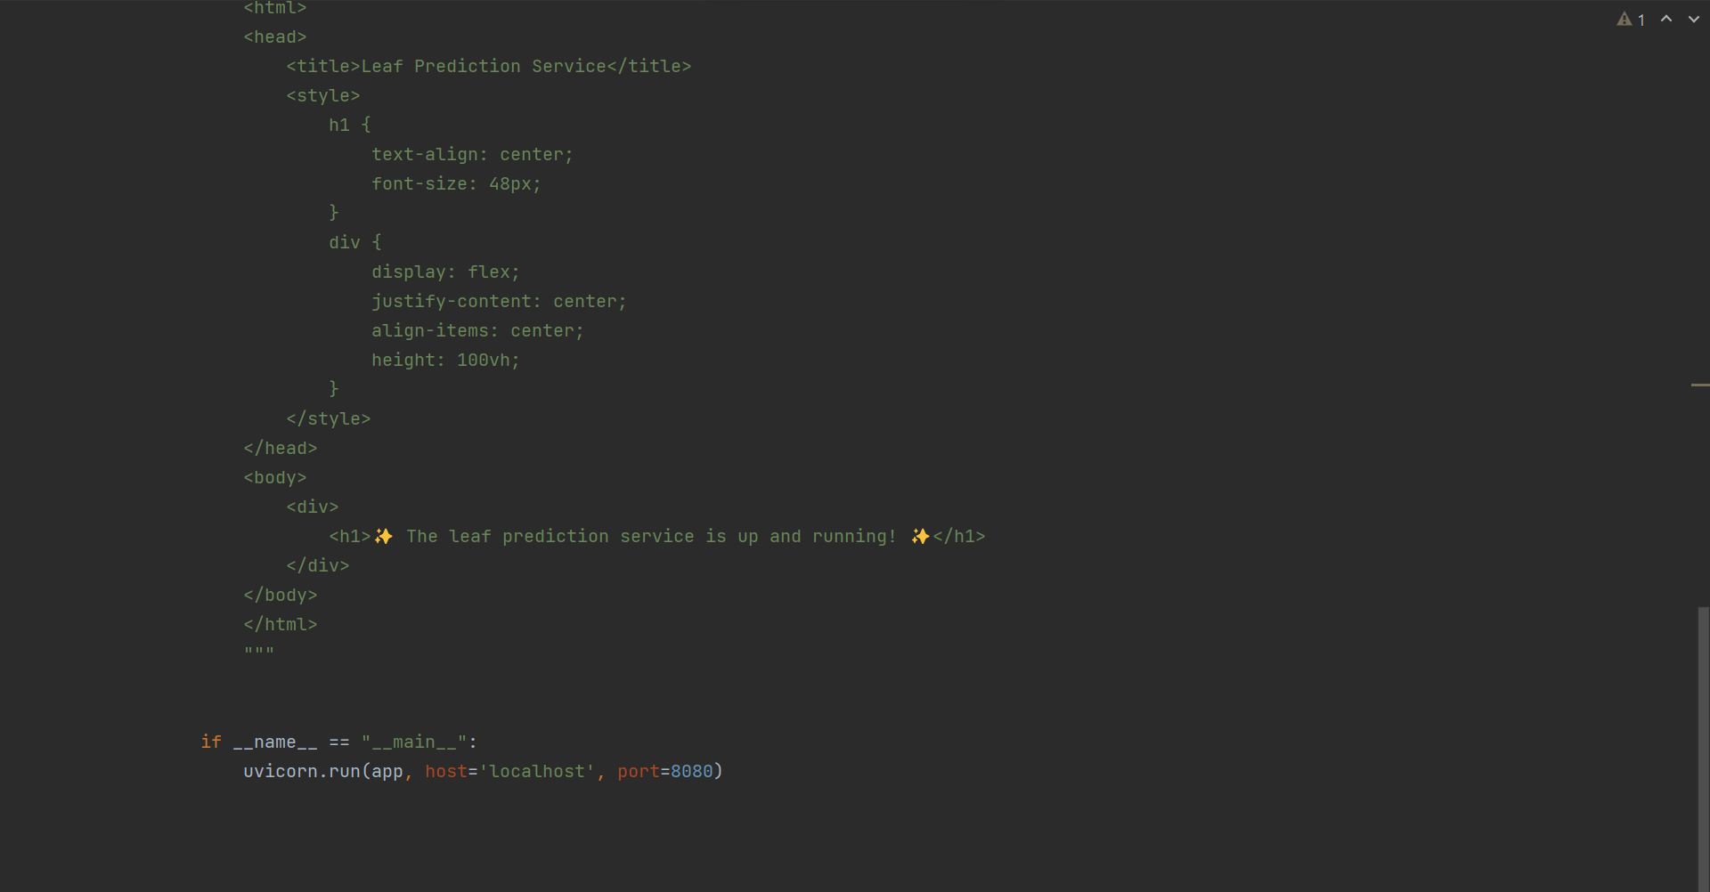
Code Implementation Contd.

Slide 20
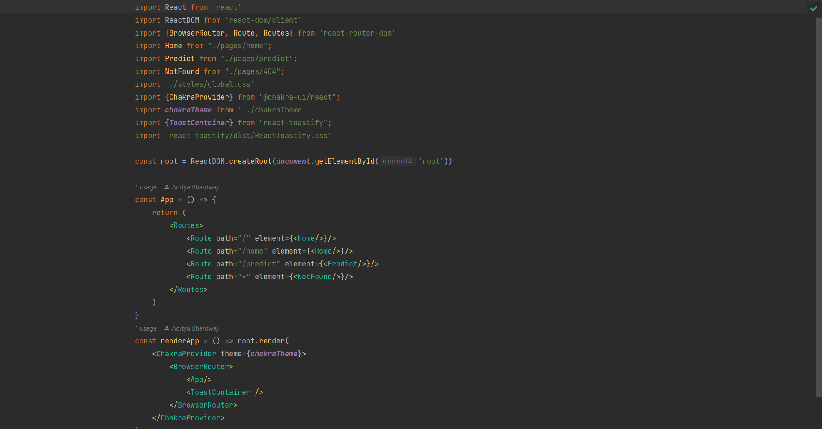
Code Implementation Contd.

Slide 21
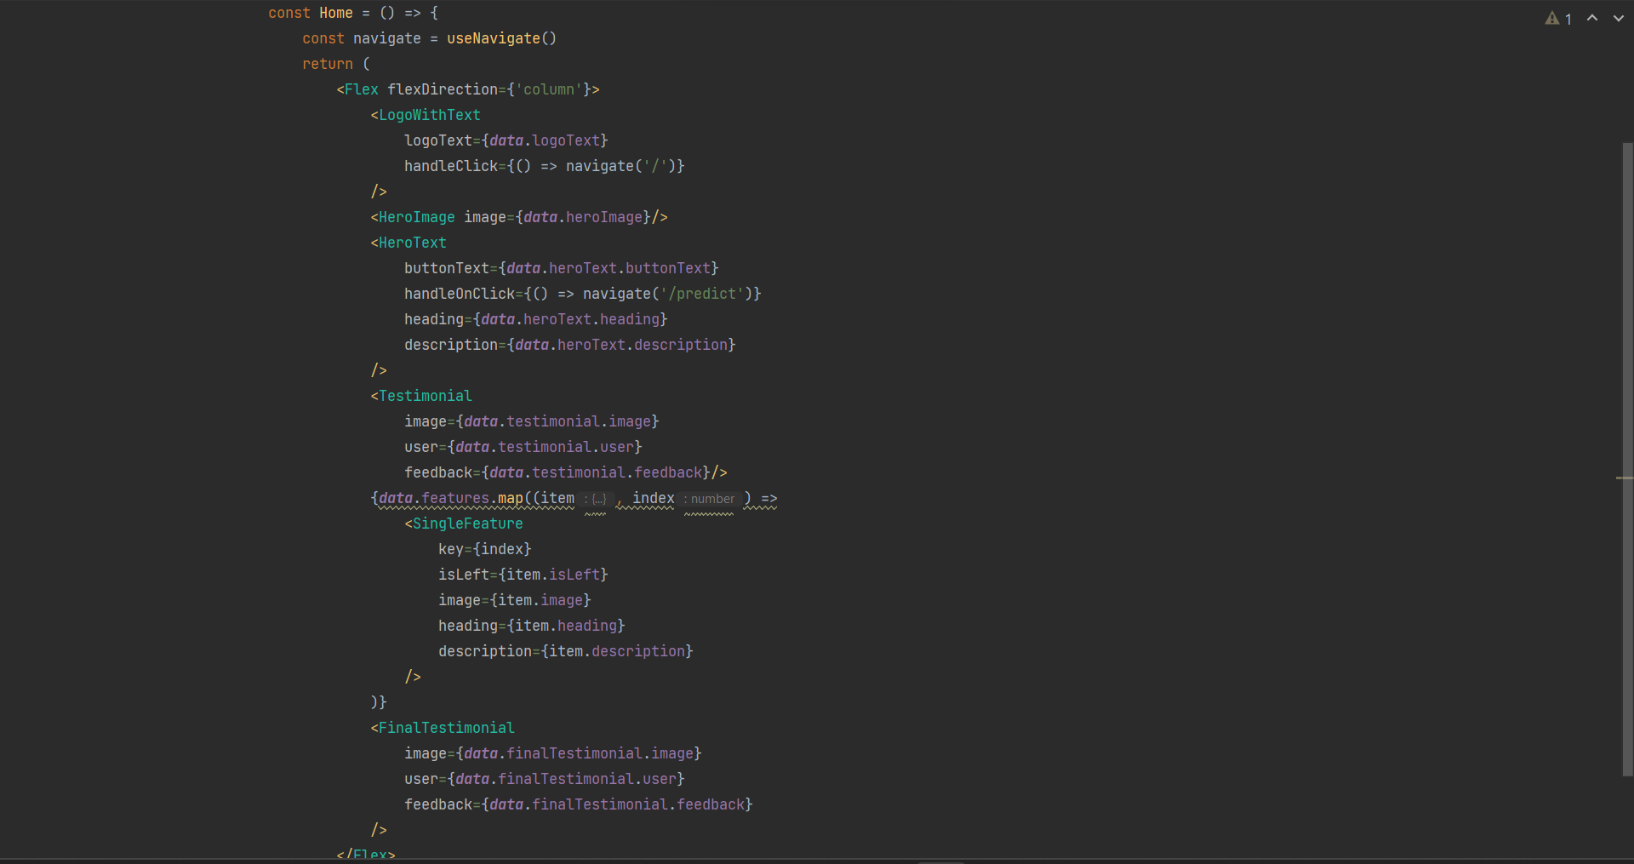
Code Implementation Contd.

Slide 22
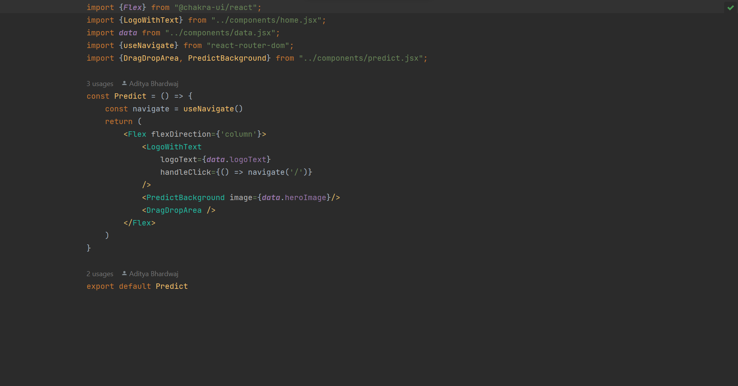
Code Implementation Contd.

Slide 23
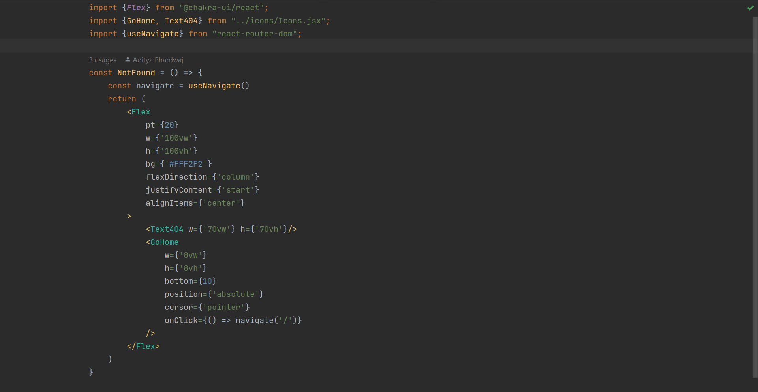
Code Implementation Contd.

Slide 24
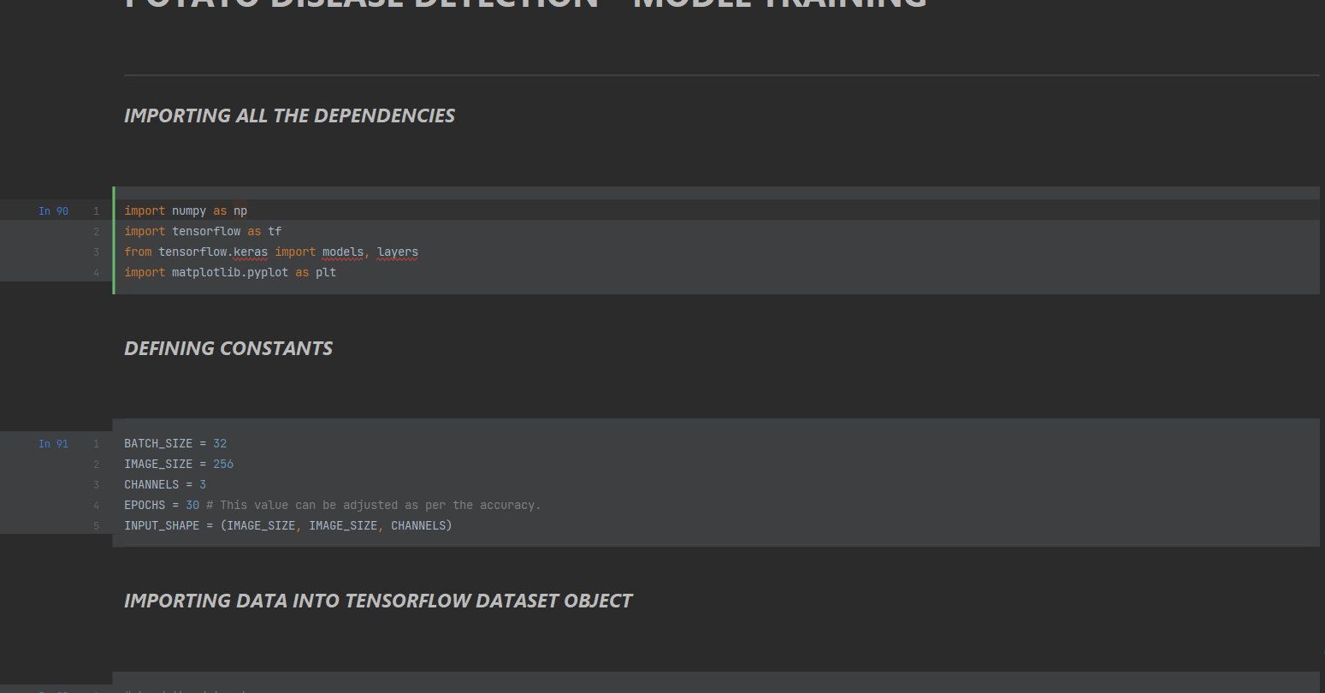
Code Implementation Contd.

Slide 25
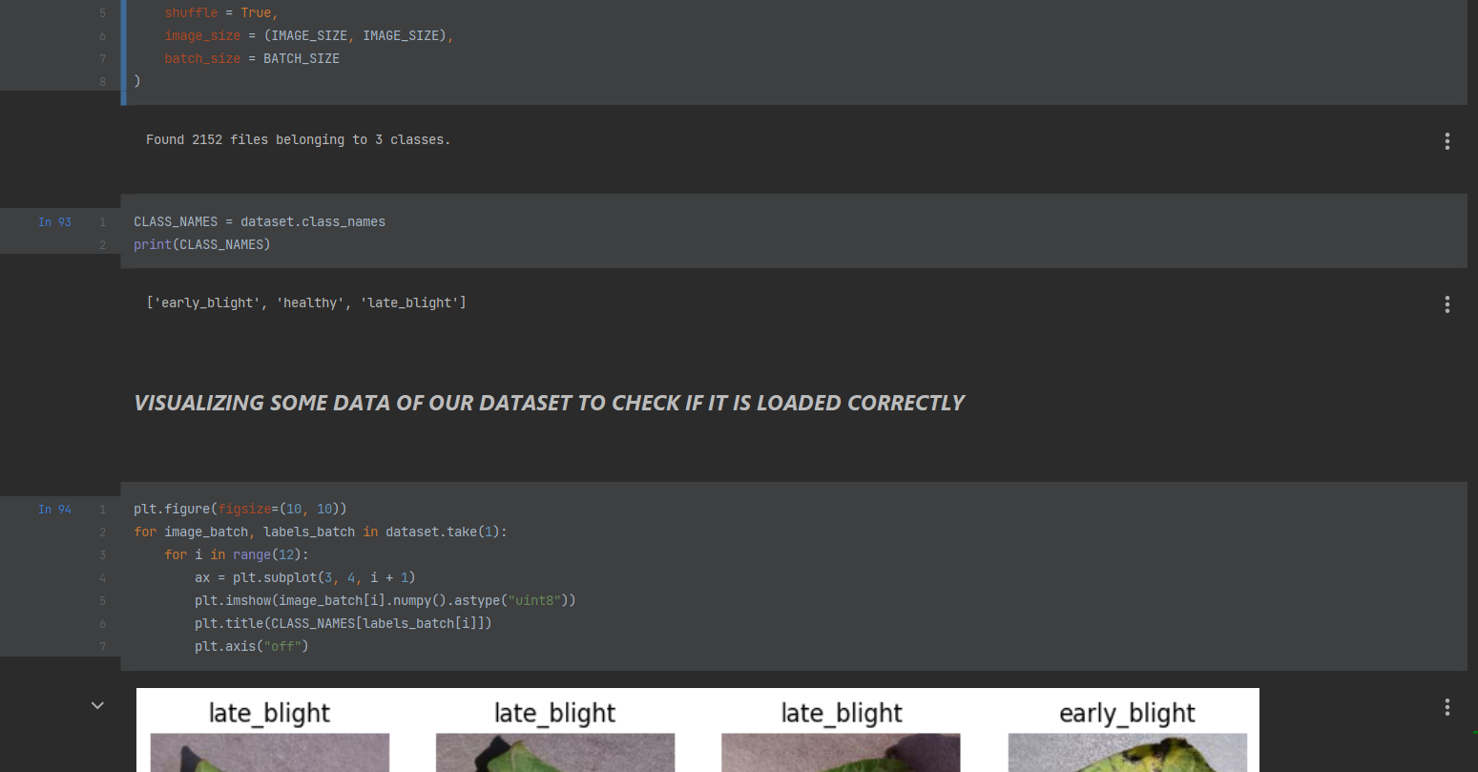
Code Implementation Contd.

Slide 26
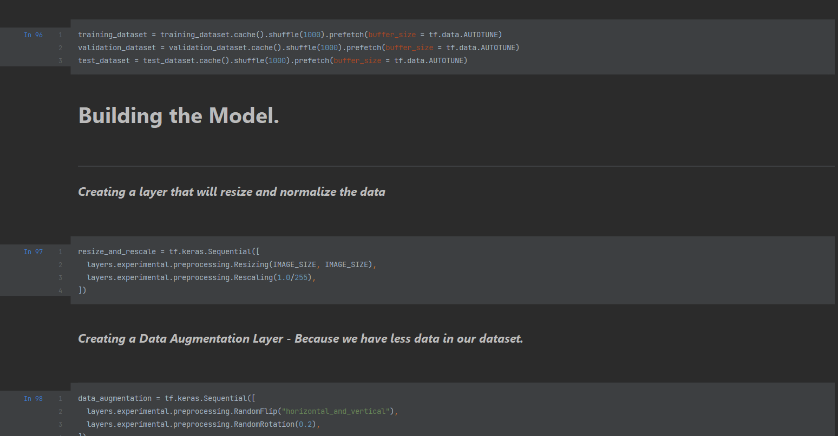
Code Implementation Contd.

Slide 27
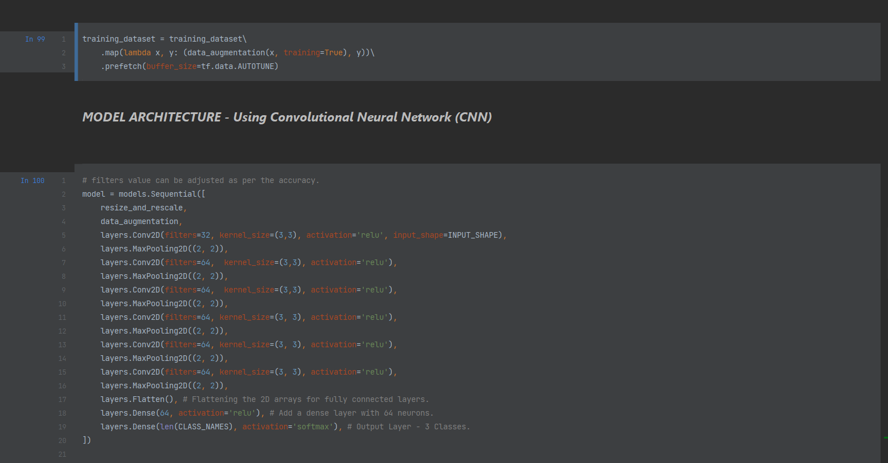
Code Implementation Contd.

Slide 28
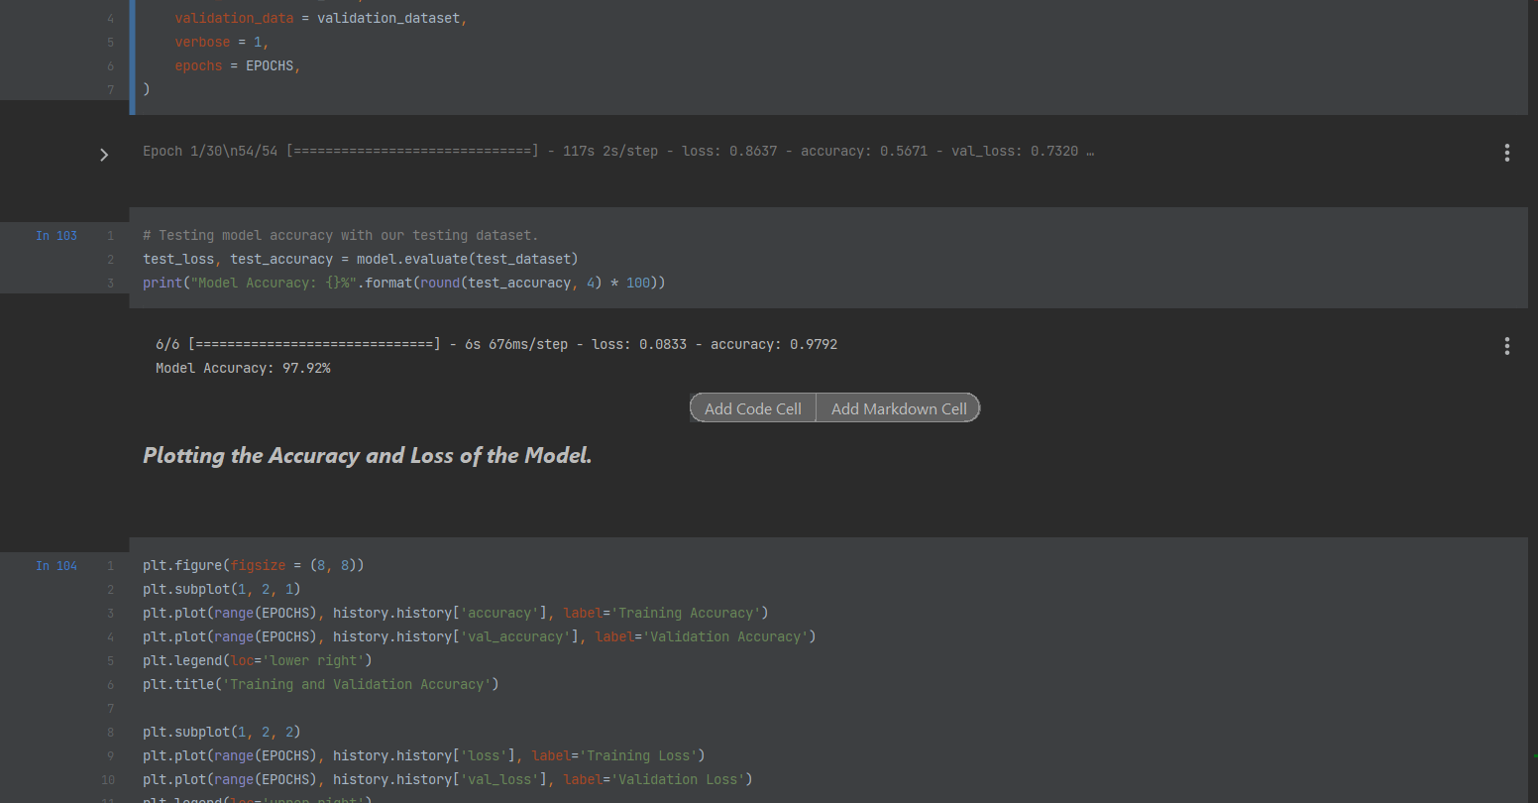
Code Implementation Contd.

Slide 29
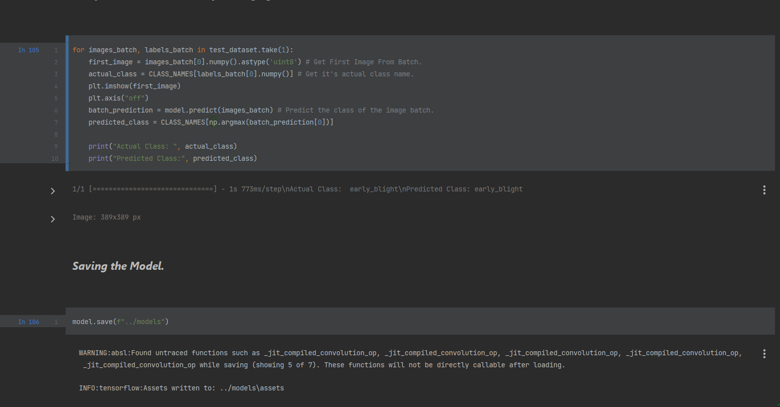
Code Implementation Contd.

Slide 30
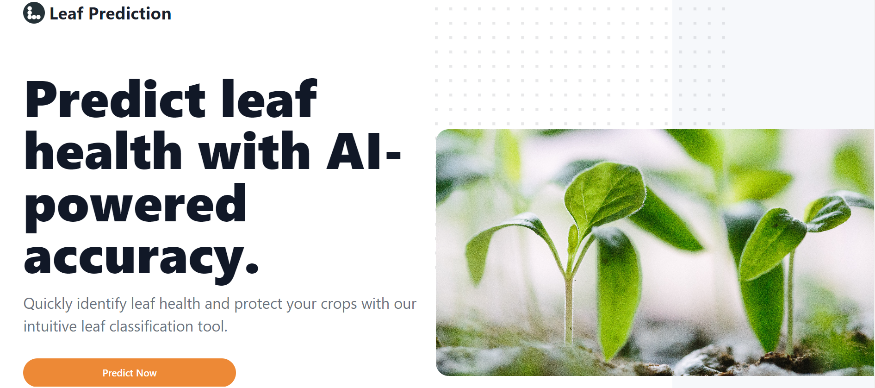
Expected Outcome

Slide 31
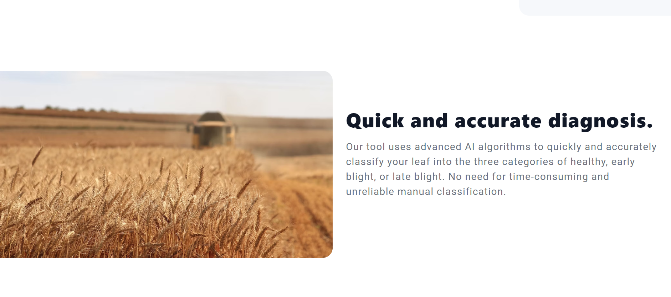
Expected Outcome Contd…

Slide 32
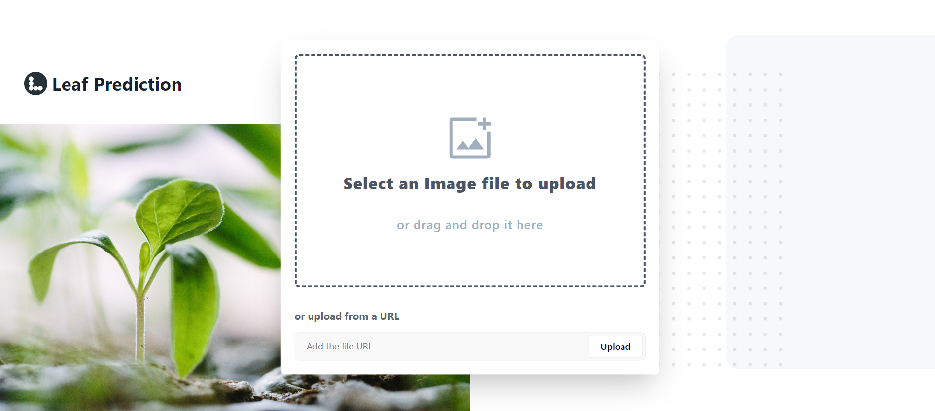
Expected Outcome Contd…

Slide 33
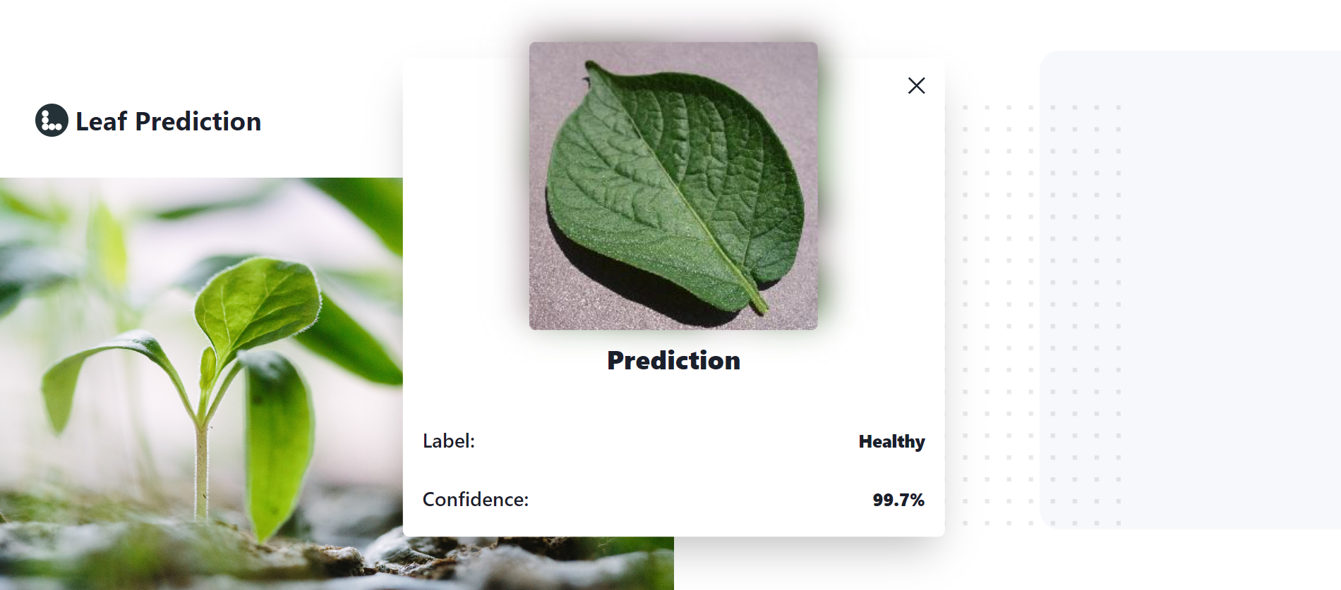
Expected Outcome Contd…

Slide 34

Expected Outcome Contd…

Slide 35
Conclusions
In conclusion, the use of machine learning techniques have been proven to be effective in the diagnosis of plant diseases.The results showed a significant improvement in accuracy, from 90% to 95%, which indicates that the method is reliable for diagnosing plant diseases.
However, there are still limitations to this approach, and further research is needed to address these challenges. One of the limitations of this approach is the need for large amounts of labeled data for training the model. Another limitation is the difficulty of distinguishing between different types of diseases that may have similar symptoms.
Despite these limitations, the potential of machine learning for plant disease diagnosis is significant. By combining advanced imaging technology with machine learning algorithms, we can accurately diagnose diseases early, leading to improved crop yield and reduced economic losses.

Slide 36
Future Work
There are several opportunities for further development and improvement of the current approach. One possibility is to extend the scope of the project to include other crops and plant species. Additionally, further research could be conducted to extract additional features from the images of plant leaves. By analyzing additional features, we may be able to increase the accuracy of our model even further.
Furthermore, the results of this study could be used to develop an app interface that can be used by farmers to diagnose plant diseases quickly and easily. By making this technology accessible to farmers worldwide, we can potentially reduce the impact of plant diseases on crop yields and increase food security.

Slide 37
References
Peng Jiang , Yuehan Chen ,Bin Liu , Dongjian He , Chunquan Liang ,’ Real-Time Detection of Apple Leaf Diseases Using Deep Learning Approach Based on Improved Convolutional Neural Networks’, ( Volume: 7 ), pp. 06 May 2019.
Zhou, R., Kaneko, S., Tanaka, F., Kayamori, M., Shimizu, M., ‘Disease detection of Cercospora Leaf Spot in sugar beet by robust template matching’, Computers and Electronics in Agriculture, Volume 108, pp.58-70, 2014.
Barbedo, J.G.A., Godoy, C.V., ‘Automatic Classification of Soybean Diseases Based on Digital Images of Leaf Symptoms’, SBI AGRO,2015.
Barbedo, J.G.A., ‘A review on the main challenges in automatic plant disease identification based on visible range images’, 2016 ,Biosystems Engineering, Volume 144, pp. 52-60.
Bashish, D.A., Braik, M., Ahmad, S.B., ‘A Framework for Detection and Classification of Plant Leaf and Stem Diseases’, International Conference on Signal and Image Processing, pp. 113-118, 2010.
Punajari, J.D., Yakkundimath, R., Byadgi, A.S., ‘Image Processing Based Detection of Fungal Diseases in Plants’, International Conference on Information and Communication Technologies, Volume 46, pp. 1802-1808, 2015

Slide 38
Thank You

